Slide 1

Hyper parameter tuning
1 Tuning process
2 Using an appropriate scale to pick hyperparameters
3 Hyperparameters tuning in practice: Pandas vs Caviar
4 Normalizing activations in a network
5 Fitting Batch Norm into a neural network
6 Why does Batch Norm work?
7 Softmax regression
8 Deep Learning frameworks
9 TensorFlow

Slide 2
Hyperparameter tuning
Tuning process

Slide 3
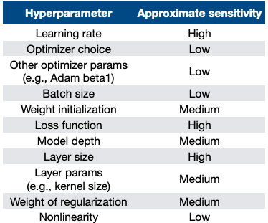
Hyperparameters

Slide 4
Hyperparameters
Hyperparameter tuning is an important process in training deep neural networks, as it involves setting various hyperparameters such as learning rate, momentum term, mini-batch size, etc. This lesson suggests some guidelines for systematically organizing the hyperparameter tuning process to converge on the best setting of hyperparameters.
The most important hyperparameter in deep learning is usually the learning rate alpha, followed by other hyperparameters such as the momentum term and mini-batch size. However, the importance of different hyperparameters can vary depending on the specific problem. Therefore, it's important to try out a range of values for each hyperparameter.

Slide 5
Hyperparameters
Traditionally, hyperparameters were sampled on a grid, but in deep learning, it's recommended to sample hyperparameters randomly instead. This is because it's difficult to know in advance which hyperparameters are most important for a specific problem. Random sampling allows for a more rich exploration of a wide range of hyperparameters, which increases the likelihood of finding the best setting.
Another common practice in hyperparameter tuning is a coarse-to-fine sampling scheme. This involves starting with a coarse sampling of the hyperparameter space and then zooming in on promising regions for more dense sampling. This can help focus resources on the most promising areas of the hyperparameter space.
Random sampling and a coarse-to-fine sampling scheme is used to systematically organize the hyperparameter tuning process. The goal is to try out a wide range of values for each hyperparameter to find the best setting for the specific problem.

Slide 6
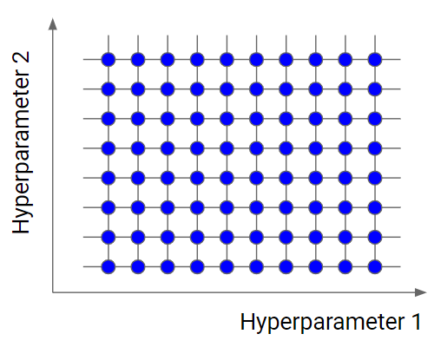
Try random values: Don’t use a grid

Slide 7




Coarse to fine
Hyperparameter 2
Hyperparameter 1

Slide 8
Hyperparameter tuning
Using an appropriate scale to pick hyperparameters

Slide 9
Picking hyperparameters at random
While sampling at random can be a useful way to search for hyperparameters, it's not always the best approach. For example, if you're trying to select the number of hidden units for a given layer, sampling uniformly at random over a range of values may be appropriate.

Slide 10
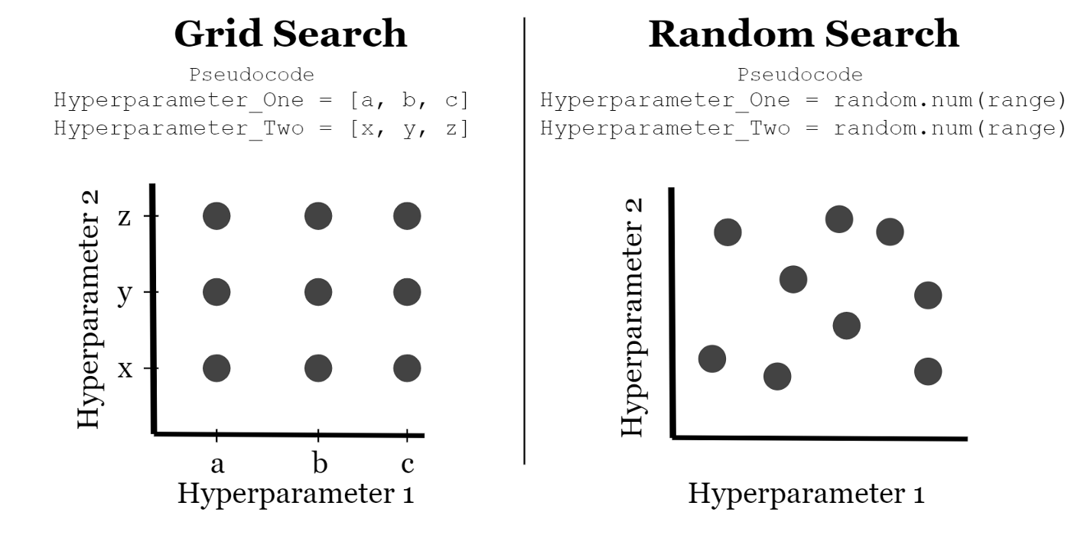
Picking hyperparameters at random

Slide 11
Appropriate scale for hyperparameters
However, for other hyperparameters, such as the learning rate alpha or the hyperparameter beta used for computing exponentially weighted averages, sampling uniformly at random over a range of values may not be the best approach.
For hyperparameters such as alpha, it's more appropriate to sample on a logarithmic scale. This allows for more resources to be dedicated to searching over the lower end of the range, where small changes in alpha can have a big impact on results. To sample on a logarithmic scale in Python, you can use the formula alpha = 10 to the power of r, where r is a random number between -4 and 0.

Slide 12
Appropriate scale for hyperparameters
For hyperparameters such as beta, it's best to explore the range of values for 1 minus beta, which ranges from 0.1 to 0.001, and sample uniformly at random over this range. This allows for more resources to be dedicated to exploring the range of values where small changes in beta can have a big impact on results.
While it's important to select the appropriate scale to explore hyperparameters, notes that even if you don't make the optimal scaling decision, you can still get okay results. Using a coarse to fine search can also be an effective way to focus on the most useful range of hyperparameter values in later iterations.
How to organize your hyperparameter search process to make it more efficient? (the next section)

Slide 13
Hyperparameters tuning
Hyperparameters tuning in practice Pandas vs Caviar

Slide 14
Hyperparameters tuning in practice Pandas vs Caviar
Some final tips and tricks for organizing the hyperparameter search process in deep learning. Intuitions about hyperparameter settings from one application area may or may not transfer to a different one. However, there is a lot of cross-fertilization among different domains, and people increasingly read research papers from other application domains to look for inspiration for cross-fertilization.
Retesting or reevaluating hyperparameters at least once every several months to make sure that the best setting of hyperparameters is not getting stale due to changes in data, algorithm development, or upgrades in servers.

Slide 15



Re-test hyperparameters occasionally
Idea
NLP, Vision, Speech, Ads, logistics, ….
Intuitions do get stale.
Re-evaluate occasionally.
Experiment
Code

Slide 16
Hyperparameters tuning in practice Pandas vs Caviar
One approach is the "panda approach," where people babysit one model gradually and patiently nudge the learning rate up or down, usually when there are limited computational resources.
The other approach is the "caviar strategy," where people train many models in parallel to try a lot of different hyperparameter settings and then quickly pick the one that works best. The choice between these two approaches depends on how much computational resources one has.
Another technique can make neural networks more robust to the choice of hyperparameters. This technique does not work for all neural networks, but when it does, it can make the hyperparameter search much easier and also make training go much faster. This technique will be introduced in the next section.

Slide 17
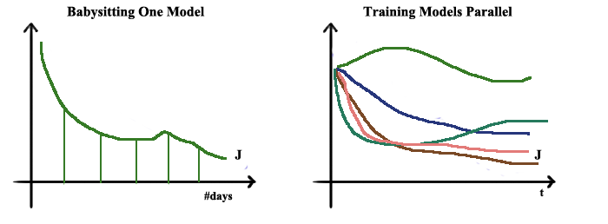

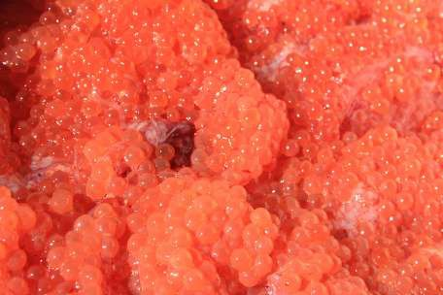
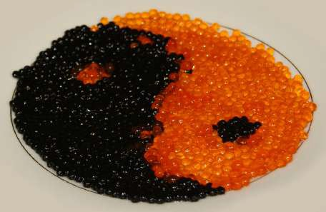
Babysitting one model
Training many models in parallel
Panda
Caviar

Slide 18
Batch Normalization
Normalizing
activations in a
network

Slide 19
Normalizing inputs to speed up learning
Batch normalization is an algorithm developed by researchers Sergey Ioffe and Christian Szegedy that is used to normalize the mean and variance of the hidden unit values in deep neural networks.
The idea is similar to how input features are normalized to speed up learning in logistic regression. However, in deep neural networks, you have multiple hidden layers, each with their own set of activations, so you want to normalize those activations to make the training of the network more efficient.
To implement batch normalization, you first compute the mean and variance of the hidden unit values, and then normalize them by subtracting off the mean and dividing by the standard deviation. This makes every component of the hidden unit have mean 0 and variance 1. However, you don't want the hidden units to always have mean 0 and variance 1, so you use learnable parameters gamma and beta to adjust the mean and variance to other values.

Slide 20
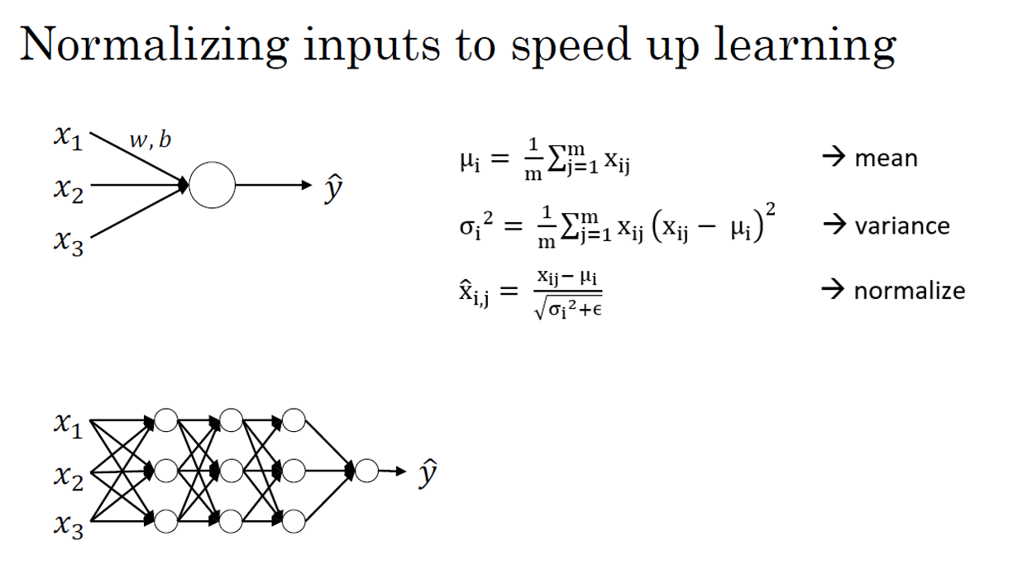

Slide 21
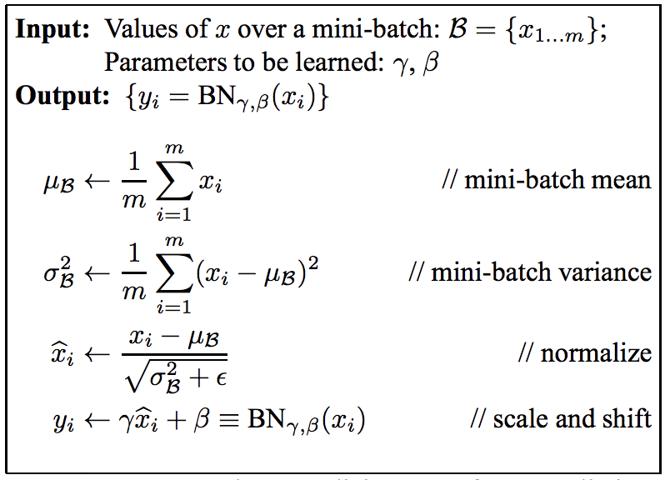
Implementing Batch Norm

Slide 22
Implementing Batch Norm
The effect of gamma and beta is that they allow you to set the mean of the normalized hidden unit values to be whatever you want it to be. By appropriately setting gamma and beta, you can make the hidden unit values have other means and variances as well. So instead of using the original hidden unit values, you use the normalized hidden unit values with gamma and beta to perform subsequent computations in the neural network.
Batch normalization is useful because it makes hyperparameter search easier, makes neural networks more robust, and enables you to train even very deep networks. In the next video, the instructor will show how to fit batch norm into a neural network and make it work for many different layers.

Slide 23
Batch Normalization
Fitting Batch Norm into a neural network

Slide 24
Implementing Batch Norm
The effect of gamma and beta is that they allow you to set the mean of the normalized hidden unit values to be whatever you want it to be. By appropriately setting gamma and beta, you can make the hidden unit values have other means and variances as well. So instead of using the original hidden unit values, you use the normalized hidden unit values with gamma and beta to perform subsequent computations in the neural network.
Batch normalization is useful because it makes hyperparameter search easier, makes neural networks more robust, and enables you to train even very deep networks. The next section will show how to fit batch norm into a neural network and make it work for many different layers.

Slide 25
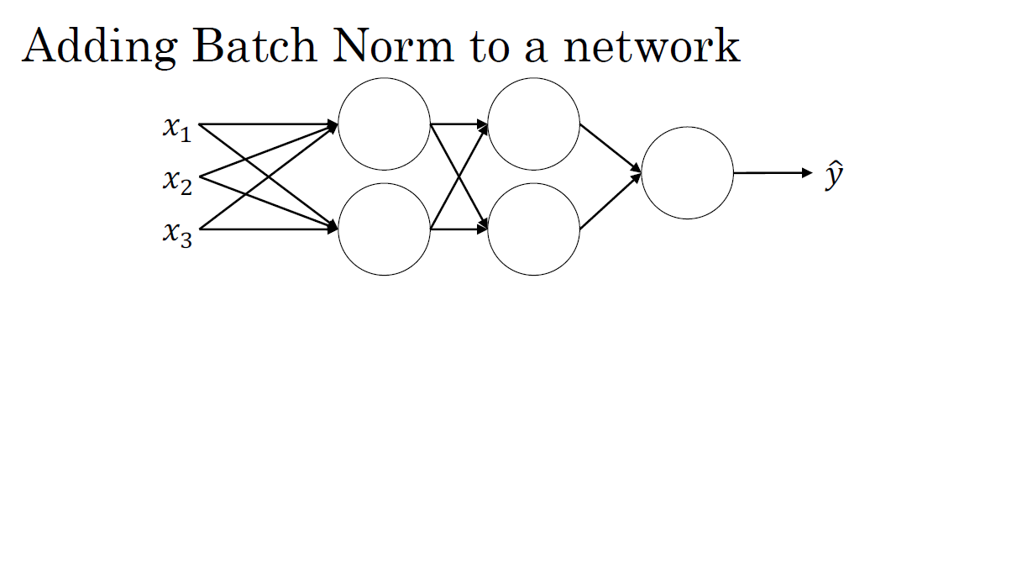
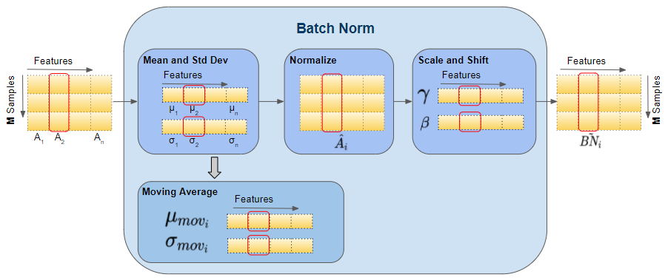
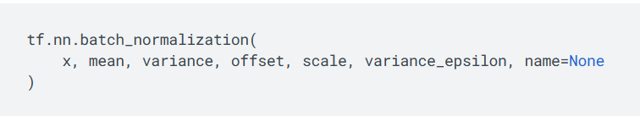
Adding Batch Norm to a network
!"
!#
!$
%&

Slide 26
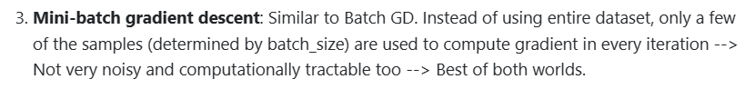
Working with mini-batches

Slide 27
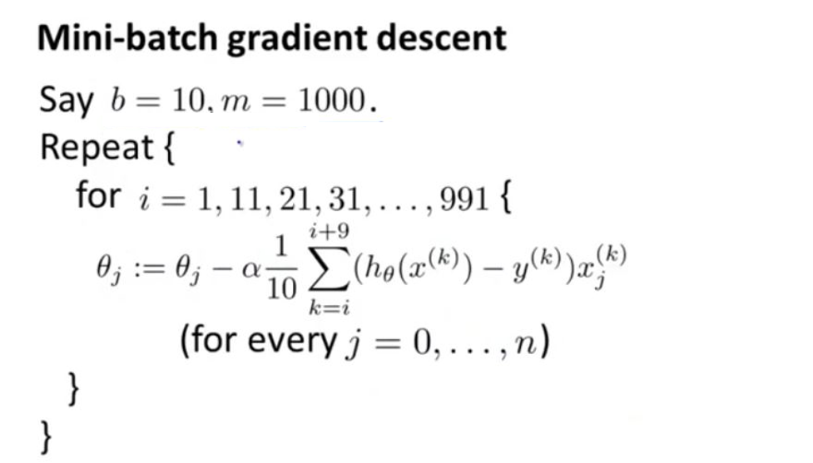
Implementing gradient descent

Slide 28
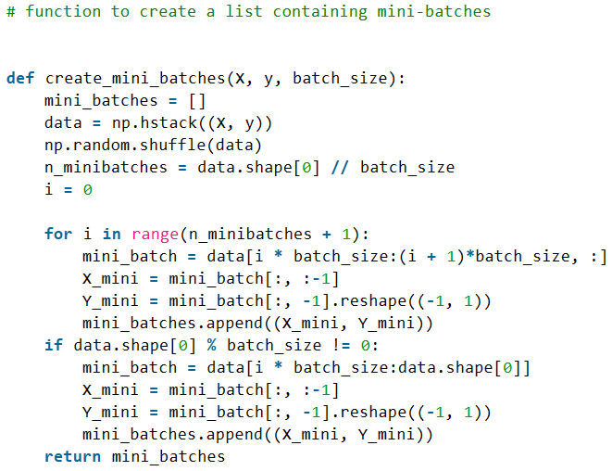
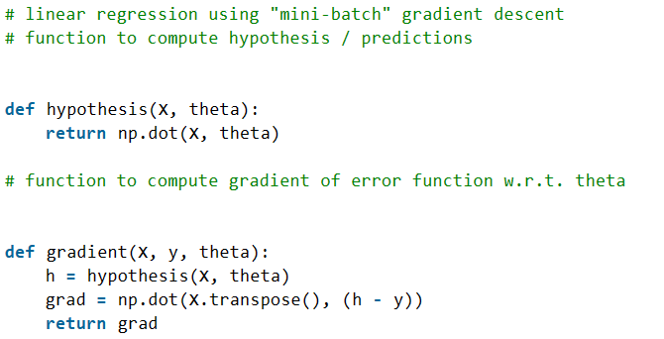
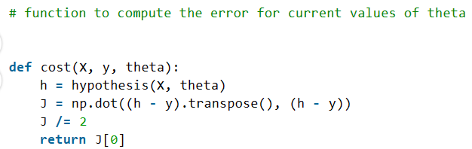
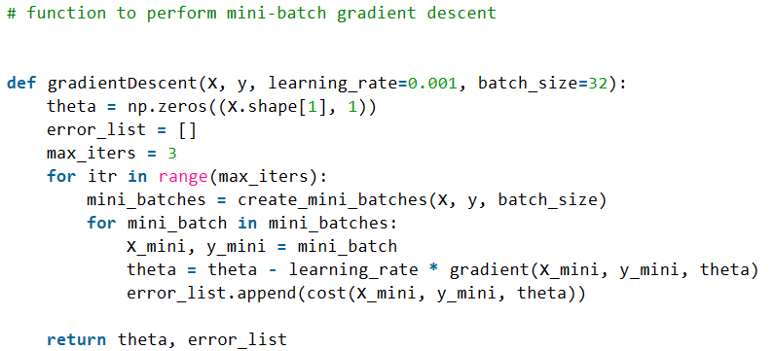
Code

Slide 29
Batch Normalization
Why does Batch Norm work?

Slide 30
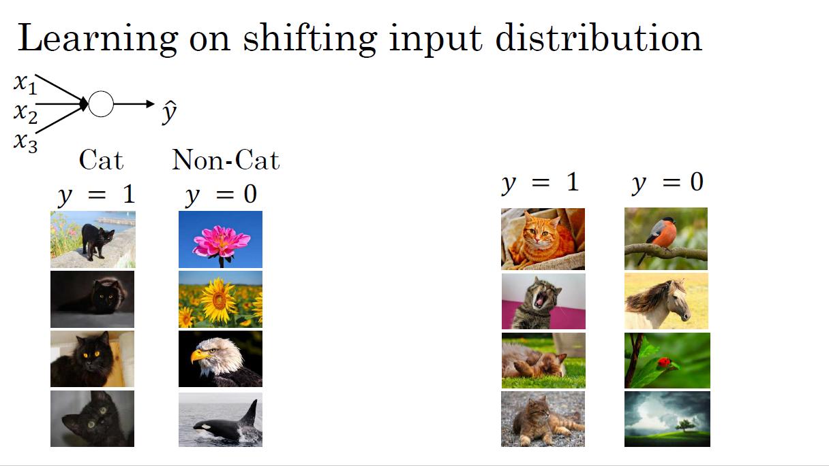

Slide 31
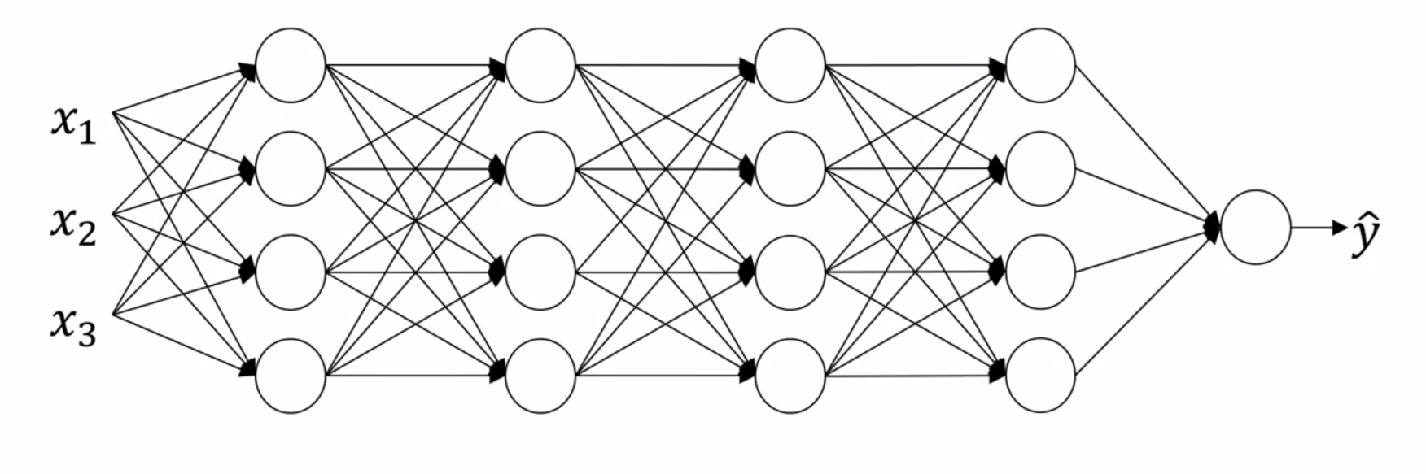
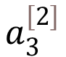
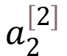
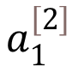

Why this is a problem with neural networks?
$$a_{1}^{\left[2\right]}$$
$$a_{2}^{\left[2\right]}$$
$$a_{3}^{\left[2\right]}$$
$$a_{4}^{\left[2\right]}$$

Slide 32
Batch Norm as regularization
Each mini-batch is scaled by the mean/variance computed on just that mini-batch.
This adds some noise to the values Z^{[L]} within that minibatch. So similar to dropout, it adds some noise to each hidden layer’s activations.
This has a slight regularization effect.

Slide 33
Multi-class classification
Softmax regression

Slide 34
Softmax regression
In binary classification, we have two possible labels, either 0 or 1, and we are trying to recognize one of two classes. However, in multiclass classification, we have multiple possible classes, and we want to recognize one of C classes. For example, instead of just recognizing cats, we want to recognize cats, dogs, and baby chicks. In this case, we have four possible classes, including an "other" or "none of the above" class.
To implement this, we need to build a new neural network with an upper layer that has C units, where C is the number of classes we want to categorize the inputs into. The output labels, represented as y hat, will be a C by 1 dimensional vector that outputs the probability of each of the C classes.

Slide 35
Softmax regression
To compute this probability, we use a Softmax layer, which is an activation function that takes in the linear output of the final layer of the neural network, z^{[L]}, and computes a temporary variable, t, by exponentiating each element of z^{[L]} . Then, the output of the Softmax layer, a^{[L]} , is obtained by normalizing t such that the sum of the entries in a^{[L]} is 1.
The Softmax layer is unusual compared to other activation functions because it takes in a vector input and outputs a vector. However, it allows us to represent linear decision boundaries between multiple classes. In addition, by adding hidden layers to the neural network, we can learn even more complex non-linear decision boundaries to separate out multiple different classes.

Slide 36
Recognizing cats, dogs, and baby chicks
Consider an example of the images and the classes they belong to. That's a picture of a baby chick, so the class is 3. Cats is class 1, dog is class 2, and a koala, so that's none of the above, so that is class 0, class 3 and so on.
C denotes the number of classes you're trying to categorize your inputs into. And in this case, there are four possible classes, including the other or the none of the above class.
The numbers indexing classes would be 0 through C – 1. Other words, that would be zero, one, two or three.
Build a new X -> Y, where the upper layer has four, or in this case the variable capital alphabet C upward units.

Slide 37
Recognizing cats, dogs, and baby chicks
N, the number of units upper layer which is layer L is going to equal to 4 or in general this is going to equal to C. And what we want is for the number of units in the upper layer to tell us what is the probability of each of these four classes.
The first node is supposed to output the probability that the image is of a cat given the input x.
The second node will output probability that image is a dog.
The third node will output the probability that image contains a baby chick given the input x.
The fourth node will give the probability of the image having none of the above clases given input x.
The output labels ŷ (y hat) is going to be a four by one dimensional vector, because it now has to output four numbers, giving you these four probabilities.

Slide 38
Recognizing cats, dogs, and baby chicks
Because probabilities should sum to one, the four numbers in the output ŷ (y hat), they should sum to one.
The standard model for getting your network to do this uses what's called a Softmax layer, and the output layer in order to generate these outputs.
in the final layer of the neural network, you are going to compute as usual the linear part of the layers. So Z^{[L]} , that's the z variable for the final layer.
So remember this last layer of the neural network is layer capital L. So as usual you compute that as Z^{[L]} =W^{[L]} TA^{[L-1]} +b^{[L]} which i weights of the layer times the activation of the previous layer plus the biases for that final layer.
Now having computed Z^{[L]} , you now need to apply what's called the Softmax activation function.
So that activation function is a bit unusual for the Softmax layer, but this is what it does.

Slide 39
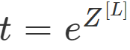
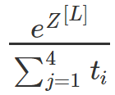
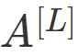
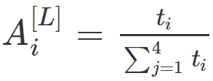
Recognizing cats, dogs, and baby chicks

Slide 40
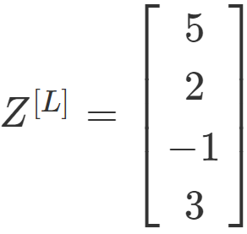
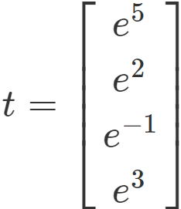
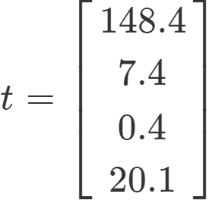
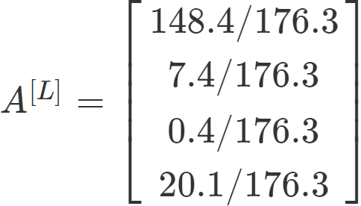
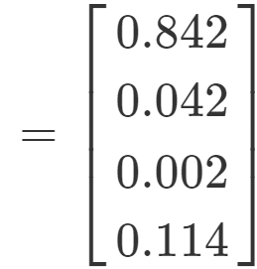
Recognizing cats, dogs, and baby chicks
Let’s say that Z[L] is a four dimensional vector, let's say is 5, 2, -1, 3
======>
======>
======>

Slide 41
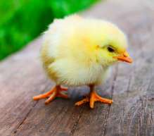

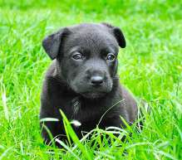
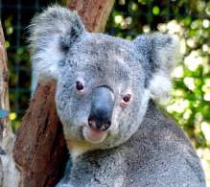
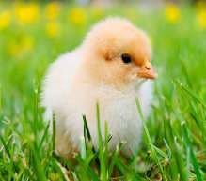

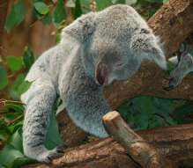

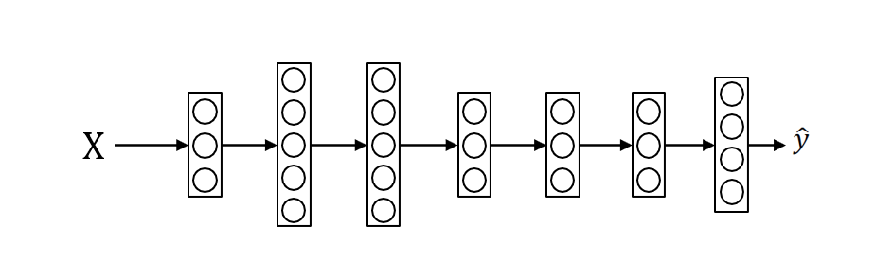
Recognizing cats, dogs, and baby chicks
3
1
2
0
3
2
0
1

Slide 42
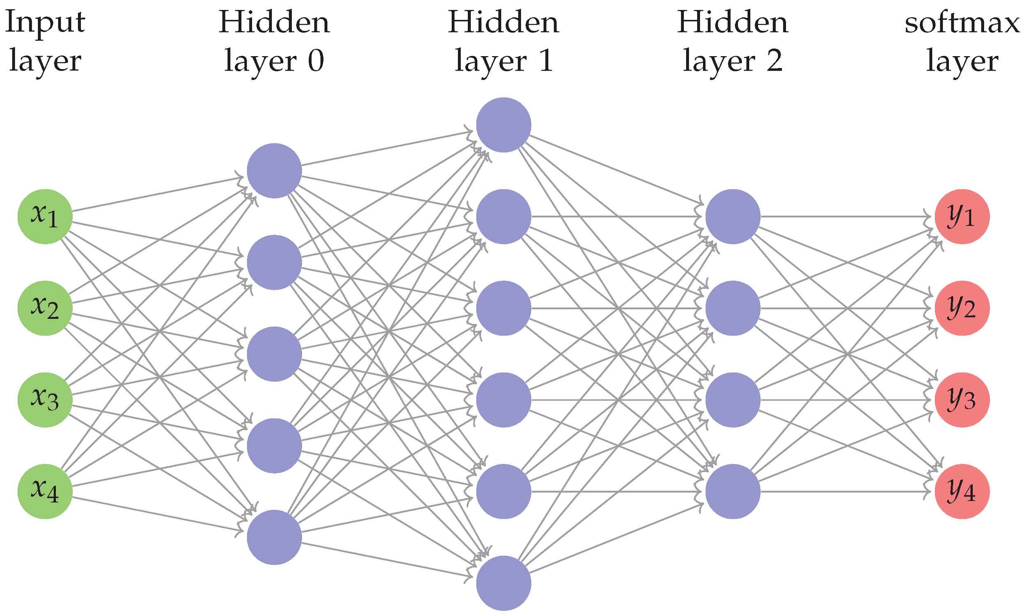
Softmax layer

Slide 43
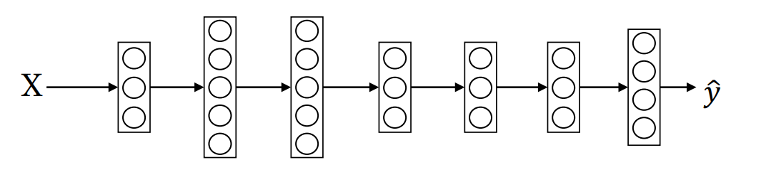
Softmax layer

Slide 44
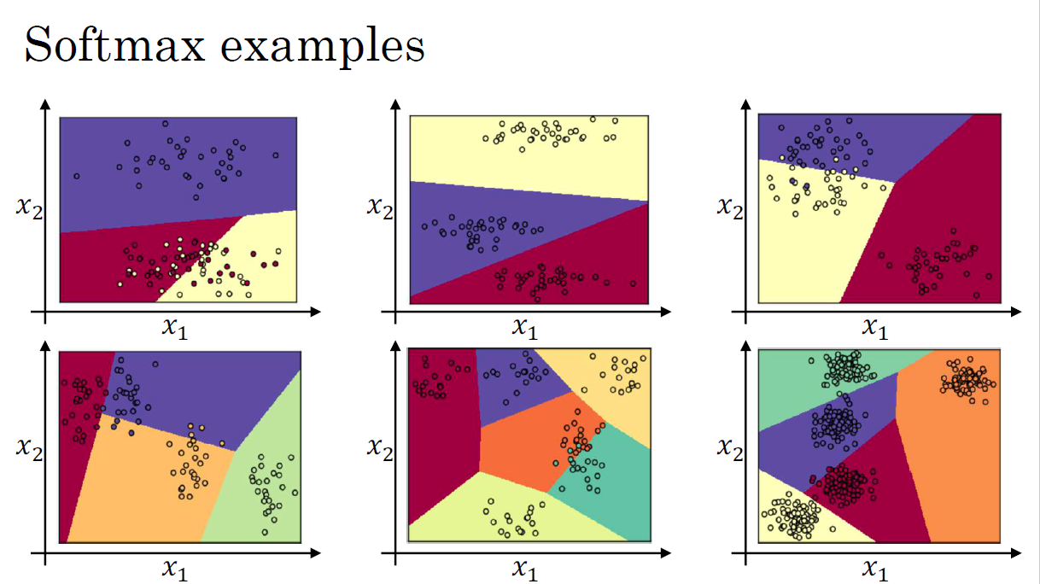

Slide 45
Softmax examples
The color on the previous plot shows fresh holding the upward of the Softmax classifier, and coloring in the input base on which one of the three outputs have the highest probability.
So we can maybe we kind of see that this is like a generalization of logistic regression with sort of linear decision boundaries, but with more than two classes class 0, 1, the class could be 0, 1, or 2. Here's another example of the decision boundary that a Softmax classifier represents when three normal datasets with three classes.
The plot has intuition that the decision boundary between any two classes will be more linear. That's why you see for example that decision boundary between the yellow and the various classes, that's the linear boundary where the purple and red linear in boundary between the purple and yellow and other linear decision boundary. But able to use these different linear functions in order to separate the space into three classes.

Slide 46
Softmax examples
Let's look at the plot some examples with more classes. So it's an example with C equals 4, so that the green class and Softmax can continue to represent these types of linear decision boundaries between multiple classes. So here's one more example with C equals 5 classes, and here's one in the plot above last example with C equals 6.
So the plot shows the type of things the Softmax classifier can do when there is no hidden layer of class, even much deeper neural network with x and then some hidden units, and then more hidden units, and so on. Then you can learn even more complex non-linear decision boundaries to separate out multiple different classes.

Slide 47
Multi-class classification
Training a Softmax Classifier

Slide 48
Training a Softmax Classifier
In binary classification, we have two possible labels, either 0 or 1, and we are trying to recognize one of two classes. However, in multiclass classification, we have multiple possible classes, and we want to recognize one of C classes. For example, instead of just recognizing cats, we want to recognize cats, dogs, and baby chicks. In this case, we have four possible classes, including an "other" or "none of the above" class.
To implement this, we need to build a new neural network with an upper layer that has C units, where C is the number of classes we want to categorize the inputs into. The output labels, represented as y hat, will be a C by 1 dimensional vector that outputs the probability of each of the C classes.

Slide 49
Programming Frameworks
Deep Learning frameworks

Slide 50
Deep learning frameworks
Caffe/Caffe2
CNTK
DL4J
Keras
Lasagne
mxnet
PaddlePaddle
TensorFlow
Theano
Torch
Choosing deep learning frameworks
Ease of programming (development and deployment)
Running speed
Truly open (open source with good governance)

Slide 51
Programming Frameworks
TensorFlow

Slide 52
TensorFlow
TensorFlow is a deep learning programming framework that can help developers be more efficient in implementing and using deep learning algorithms.

Slide 53
Motivation problem
J(w) = w² - 10w + 25
(cost)
(w - 5)²
w = 5
J(w, b)

Slide 54
Code example
import numpy as np import tensorflow as tf
coefficients = np.array([[1], [-20], [25]])
w = tf.Variable([0],dtype=tf.float32)
x = tf.placeholder(tf.float32, [3,1])
cost = x[0][0]*w**2 + x[1][0]*w + x[2][0]
# (w-5)**2
train = tf.train.GradientDescentOptimizer(0.01).minimize(cost)
init = tf.global_variables_initializer()
session = tf.Session() session.run(init) print(session.run(w))
with tf.Session() as session: session.run(init) print(session.run(w))
for i in range(1000):
session.run(train, feed_dict={x:coefficients}) print(session.run(w))

